Slide 1

Introduction

Slide 2
Course Outline
Unit 1: Introduction to Database Management
Database System Applications, Purpose, View of data, Database Languages, Database design, Introduction to databases, Database application architecture, Users and Administrators, E-R Model, reducing ER to a relational schema. Structure of relational databases, Database schema, and its constraints, Keys
14 Hours
Unit 2: Relational Model and Database Design
Relational operations (Algebra), Unary Operations - Unity, Binary, Aggregate Functions, Grouping, SQL ,overview, Data definition, Structure of SQL queries, Additional Basic Operations, Set Operations, Null Values, Aggregate Functions, Nested Subqueries, Database Modification, Join expressions, Views, Triggers, Functions, and Procedures, Introduction to strategies of Query processing and Query optimization.
14 Hours

Slide 3
Course Outline
Unit 3: Advanced Design Concepts and Implementation
Functional Dependencies, Inference Rules, Closure, Equivalence, Minimal Cover Normal Forms Based on Primary Keys (1NF, 2NF, and 3NF), General Definitions of Second and Third Normal Forms Boyce-Codd Normal Form, Properties of Relational Decompositions, Overview of Higher Normal Forms.
14 Hours
Unit 4: Advanced Databases
Database transactions, Concurrency control, Locking, Recovery, Database Security, Introduction to NoSQL databases, Document database (MongoDB), Key-Value database (DynamoDB), Graph databases (Neo4j), Wide-column store database (HBase)
14 Hours

Slide 4
Course Outline
Lab/Hands-on sessions
Draw an ER diagram for a given problem statement
Conversion of an ER diagram into Relational schema
DDL – create, constraints, alter, rename, drop, truncate table, Views. DML – Insert, Update, Delete, Transactions - commit, rollback, savepoint
SQL - Set operators: union, intersect, minus.
SQL – Aggregate functions.
SQL – Joins: inner, outer; Sub queries: correlated and uncorrelated. SQL – Creating Functions and Procedures
SQL – Creating Triggers and Cursors
XML- Database access. NoSQL database queries
High-level programming language accessing a database using an API.
Tools/ Languages: MySQL Workbench, Python, ERwin, Any other tool for ER modeling

Slide 5
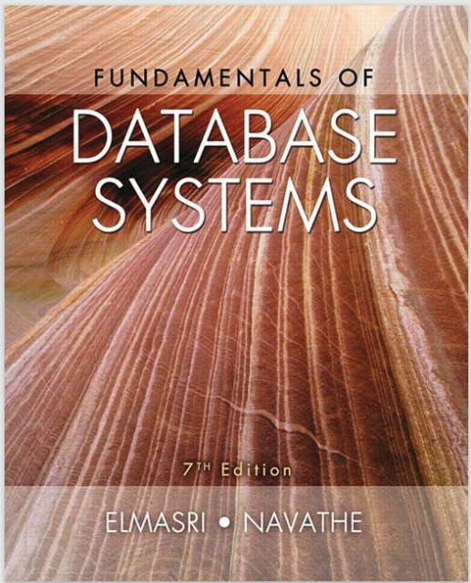

Textbooks
Textbook 1 (TB1)
Textbook 2 (TB2)

Slide 6
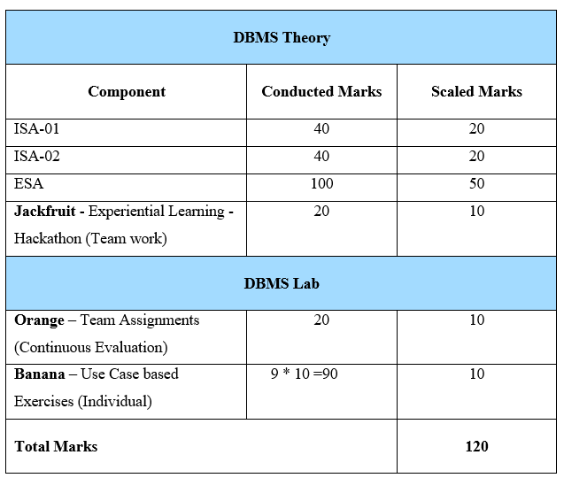
Course Evaluation Policy : Tentative
DBMS- 5 credits course

Slide 7

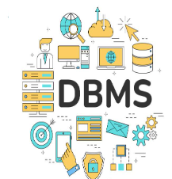
Database Management Systems
Unit 1: Introduction to Database Management
Slides adapted from Author Slides of “Database System Concepts”, Silberschatz, H Korth and S Sudarshan, McGrawHill, 7th Edition, 2019. And Author Slides of Fundamentals of Database Systems”, Ramez Elamsri, Shamkant B Navathe, Pearson, 7th Edition, 2017.

Slide 8



Introduction
Have you ever wondered on how a large e-commerce website like Amazon is able to retrieve the products that you would want to purchase?
Nowadays social media (eg: Instagram) one of the most active platforms where people post their day to day activities etc. how and where is all these information stored? By typing a person's name we can get to see their entire profile, posts that person has posted how is this possible?
In a bank, multiple transactions take place everyday. Even if 2 transactions are happening simultaneously from account, still the money in the accounts is properly deducted and credited how does this happen?

Slide 9


Introduction
Suppose you visit your doctor for a general checkup. Now by typing in your name or your ID, all your medical history details would be visible to the doctor. How does this happen?
When you search for a specific topic on Google, how does the search engine quickly retrieve relevant web pages from millions of websites and present them to you?

Slide 10

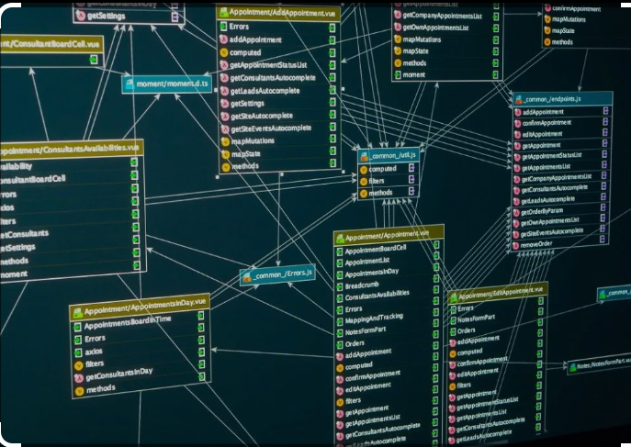
Introduction
All the above questions have a single answer and that is DATABASE
Before going ahead and understanding what database exactly and how is designed and used for all the other application, let us try answering a few more questions:
What do you mean by Data?
How is it different from Information?
In current world, there is a lot of data that is available, how are all these stored or organised so that we can get the required information?

Slide 11
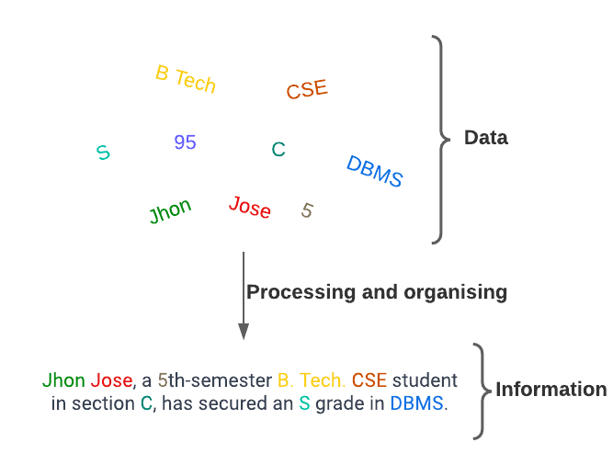
What Do you mean by Data & Information?
Data
Data represents the raw material, like individual puzzle pieces, that serves as the foundation for knowledge.
Data is a raw and unorganized fact that is required to be processed to make it meaningful.
Information
When data is processed, organized, structured, or presented in a given context to make it useful is called information.
Data is a collection of facts, while information puts those facts into context
It is organized and is utilized by humans in some significant way to make decisions and draw some conclusions
Data doesn’t depend on information, Information depends on data

Slide 12
What is a Database?
Database
A database is a collection of related data representing some aspect of the real world, also called the mini-world or the universe of discourse (UoD).
It is a logically coherent collection, meaning it is not just a random assortment of data but is organized with inherent meaning and structure.
Databases are designed, built, and populated for a specific purpose, catering to the needs of applications or systems that interact with them.
They can vary in size and complexity, ranging from small databases used by individual applications to large-scale enterprise databases handling vast amounts of data.
Could you think of what do these individual terms mean w.r.t student information Database?

Slide 13
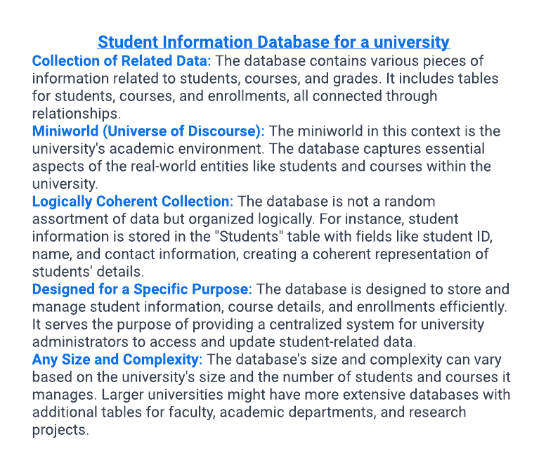
What is a Database

Slide 14
Database Management System
Database Management System
A modern database system is a complex software system whose task is to manage a large, complex collection of data.
DBMS contains information about a particular enterprise
Collection of interrelated data
Set of programs to access the data
An environment that is both convenient and efficient to use
Database systems are used to manage collections of data that are:
Highly valuable
Relatively large
Accessed by multiple users and applications, often at the same time.
Let us break these statements down further and understand them in the context of the student information database

Slide 15
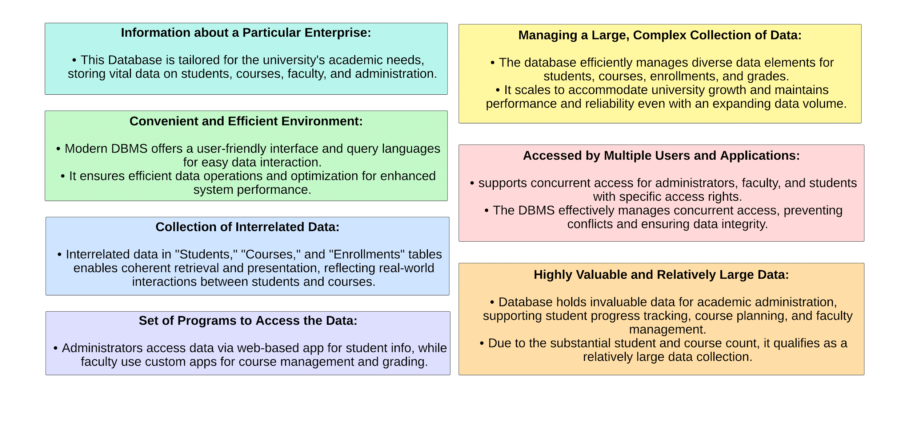
Student Information Database
Notes:
Information about a Particular Enterprise: The Student Information Database is specific to the university, representing the enterprise's academic environment. It contains essential information about students, courses, faculty, and administrative details relevant to the university's operations.
Convenient and Efficient Environment: A modern DBMS offers a convenient and efficient environment for managing data. It provides user-friendly interfaces and query languages that make it easy for users to interact with the data and retrieve specific information, such as generating class rosters or viewing students' academic records. The DBMS ensures that data operations are executed efficiently, optimizing data storage and retrieval to enhance system performance.
Collection of Interrelated Data: the data in the "Students" table is connected to the "Courses" table through the "Enrollments" table, establishing relationships among students, courses, and enrollments. These relationships enable the DBMS to retrieve and present data coherently, reflecting the real-world interactions between students and courses.
Set of Programs to Access the Data: University administrators can use a web-based application to view and update student information, while faculty members can access the database using custom-built applications to manage their courses and grading.
Managing a Large, Complex Collection of Data: the database is capable of handling a substantial amount of data. It efficiently manages diverse data elements related to students, courses, enrollments, grades, and more. As the university grows and more students enroll in various courses, the database system can accommodate the expanding data volume while maintaining performance and reliability.
Accessed by Multiple Users and Applications: The Student Information Database is accessed by multiple users, including administrators, faculty, and students, often simultaneously. Each user group has specific access rights to ensure data security and privacy. Faculty members may need to retrieve class rosters, while administrators handle student enrollments and maintain the database. The DBMS ensures that concurrent access is managed effectively to prevent conflicts and maintain data integrity.
Highly Valuable and Relatively Large Data: The Student Information Database contains highly valuable data, as it forms the backbone of the university's academic administration.
It stores critical information that supports student progress tracking, course planning, and faculty management. As the university serves a considerable number of students and courses, the database qualifies as a relatively large collection of data.

Slide 16
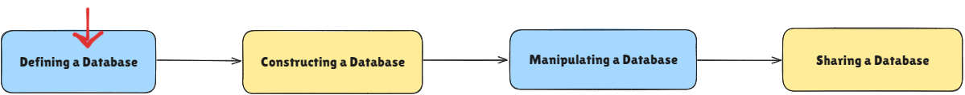
Database Management System
Database Management System
A general-purpose software system that facilitates the processes of defining, constructing, manipulating, and sharing databases among various users and applications
Defining a database involves specifying the data types, structures, and constraints of the data to be stored in the database. By defining the structure and data types, the DBMS ensures the consistency and integrity of the stored data.
The "Students" table may include fields such as "Student ID" (numeric), "Name" (text), "Email" (text), "Date of Birth" (date), and "Major" (text).
The "Courses" table may have fields like "Course ID" (numeric), "Course Name" (text), "Credits" (numeric), and "Instructor" (text).

Slide 17
Database Management System
Database Management System
A general-purpose software system that facilitates the processes of defining, constructing, manipulating, and sharing databases among various users and applications
Constructing the database is the process of storing the data on some storage medium that is controlled by the DBMS. It organizes the data in a way that allows for efficient retrieval and manipulation. The DBMS ensures data is securely stored and can be accessed by authorized users or applications.
The DBMS may store the Student Information Database on a server with appropriate data storage capacity and performance capabilities.

Slide 18
Database Management System
Database Management System
A general-purpose software system that facilitates the processes of defining, constructing, manipulating, and sharing databases among various users and applications
Manipulating a database includes functions such as querying the database to retrieve specific data, updating the database to reflect changes in the mini world, and generating reports from the data. It ensures that any changes made to the database follow predefined constraints and maintain data consistency.
A university administrator may use SQL queries to retrieve specific information, such as "Retrieve all students enrolled in Computer Science courses." The DBMS processes the query, retrieves the relevant data from the database, and presents it to the user.
Allows authorized users to update the database, such as adding new students or updating grades.

Slide 19
Database Management System
Database Management System
A general-purpose software system that facilitates the processes of defining, constructing, manipulating, and sharing databases among various users and applications
Sharing a database allows multiple users and programs to access the database simultaneously, provided they have the necessary permissions
Faculty members, administrative staff, and students can access relevant information concurrently, as long as they have the necessary permissions.
For example, faculty members can access student details for their courses, while administrators can update and maintain the overall database.

Slide 20
Questions
Some questions to revise
How do you define data, and how does it differ from information in the context of database management systems?
List out the data types you would take to define a database for an online bookstore.
Explain the role of a DBMS in managing highly valuable and relatively large collections of data. Why is this important for organizations?
What are some of the common operations performed on a database? How do these operations interact with the data stored in the database?

Slide 21
How are databases used?
Some online resources -
https://dev.mysql.com/doc/
https://www.oracle.com/in/database/what-is-database/
https://docs.oracle.com/cd/E17952_01/index.html
https://downloads.mysql.com/docs/mysql-tutorial-excerpt-8.0-en.a4.pdf

Slide 22

THANK YOU
S Nagasundari
Department of Computer Science and Engineering
nagasundaris@pes.edu

